Slide 1
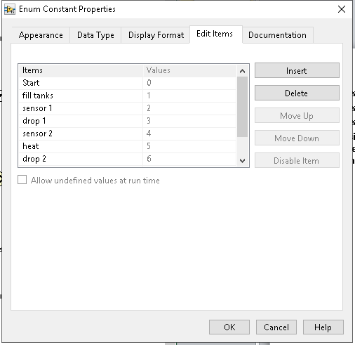
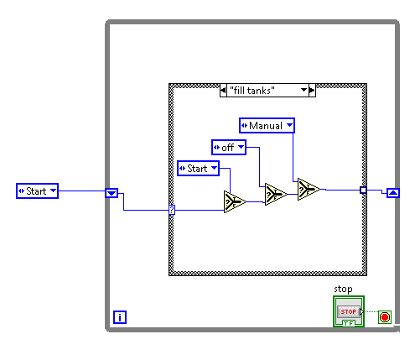
Setup Cases
1. Create while loop, with control and shift register
2. Create enum constant, edit items under properties with the cases
3. Create case structure, add case for every item
4. Inside case place three selectors, connect enum to the first lower input, connect the output of each selector to the next lower input, copy enum placing 3 copies inside case connecting to the top of each selector

Slide 2
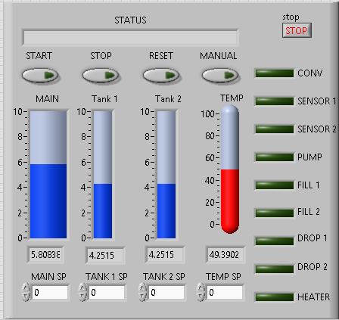
Add controls and Indicators front Panel
String Indicator
Analog Controls -Tank set points, temp set point.
Analog Indicators -Main tank , Tank 1, Tank 2, Temp; make them have digital displays
Digital controls - start, reset, stop, Manual
Digital Indicators – sensor 1, sensor 2, fill 1, fill 2, drop 1, drop 2, pump, conveyor, heater
Set all switches operation under properties to switch until released

Slide 3
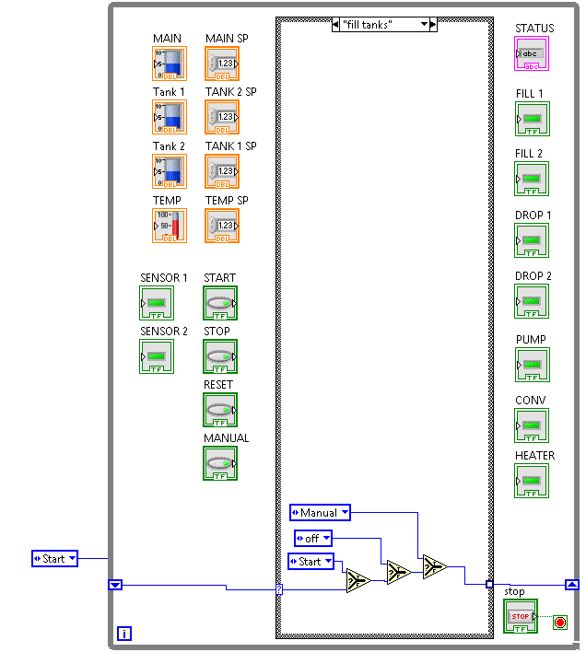
Arrange Controls and Indicators on block Diagram

Slide 4
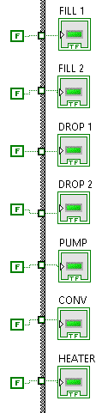
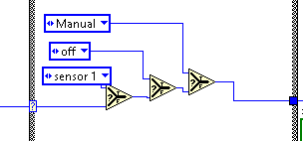

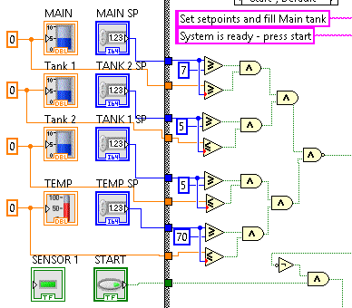
Setup each CASE - START CASE
Copy selectors to each case changing the first selector upper input to the next case.
2. Add condition to each case

Slide 5
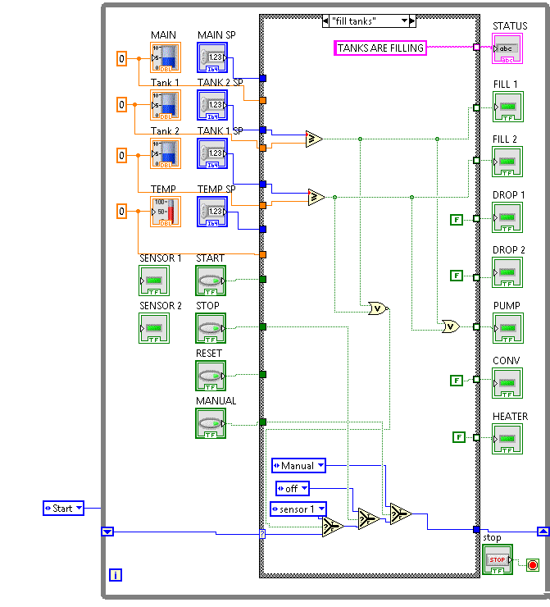
FILLING TANKS

Slide 6
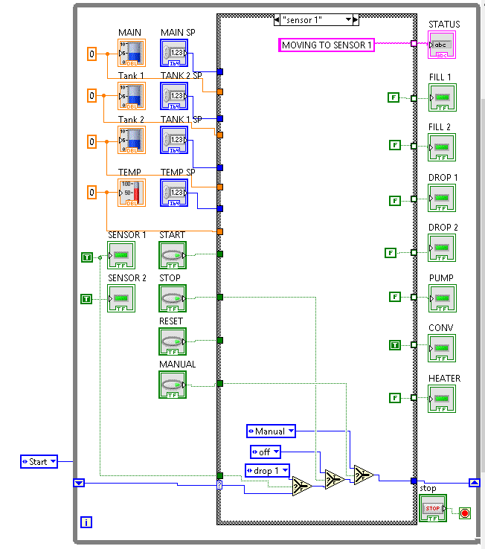
MOVING TO SENSOR 1

Slide 7
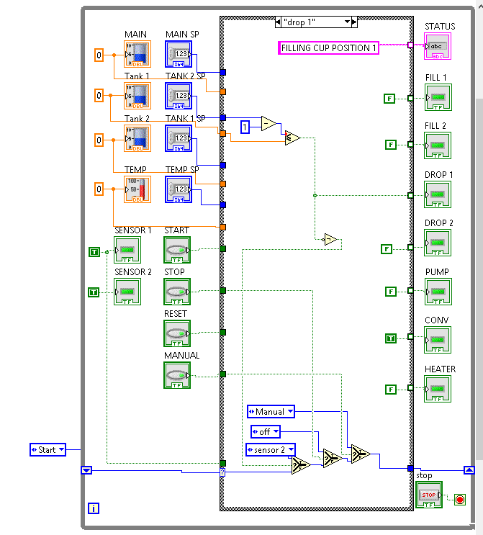
FILLING CUP AT POSTION 1

Slide 8
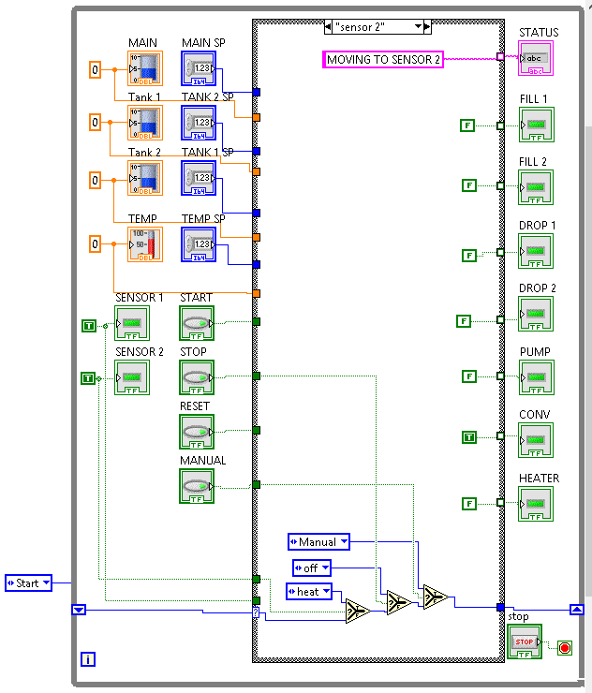
MOVING TO POSTION 2

Slide 9
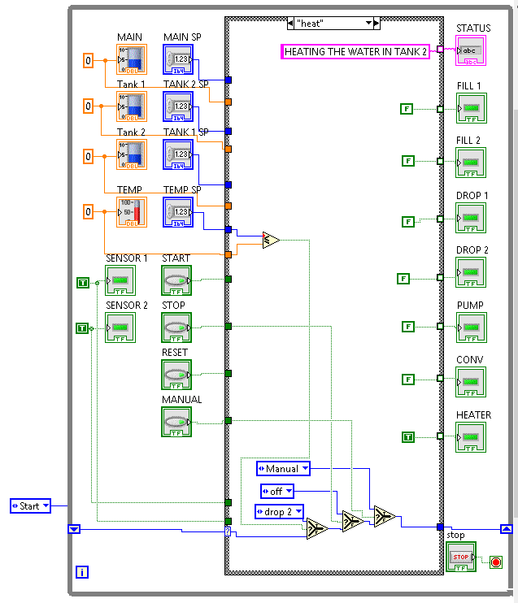
HEATING WATER

Slide 10
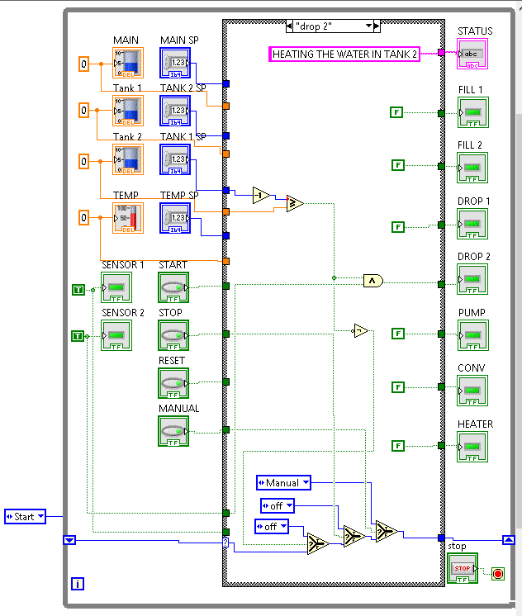
FILLING THE CUP AT POSITION 2

Slide 11
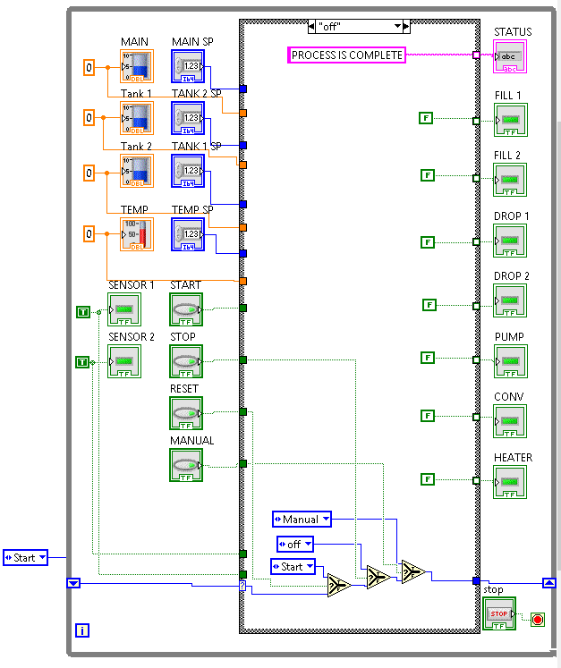
OFF

Slide 12
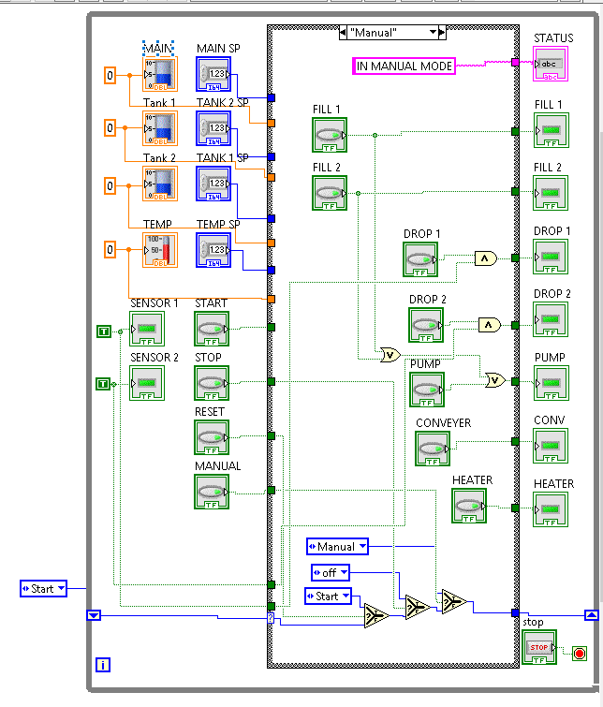
MANUAL

